Slide 1
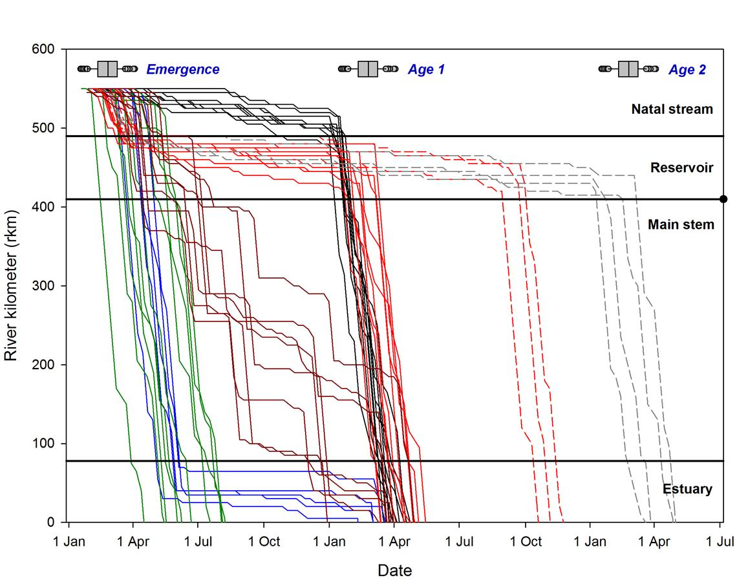
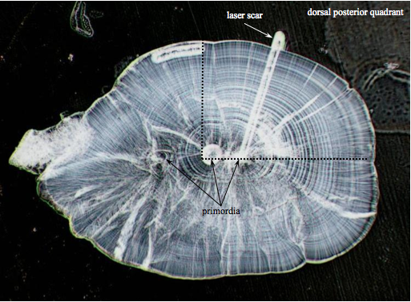
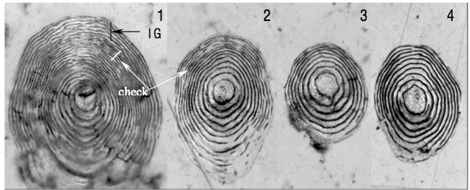


Progress toward reconstructing life history variation, composition and fitness differences among sub-basin populations of UWR Chinook salmon
M. Keefer¹, S. Bourret¹, C. Caudill¹, B. Kennedy¹,
G. Taylor², B. Clemens³, and C. Sharpe³
¹Department of Fish and Wildlife Sciences, University of Idaho
²U.S. Army Corps of Engineers, Willamette Valley Projects
³Oregon Department of Fish and Wildlife, Corvallis Research Lab

Slide 2

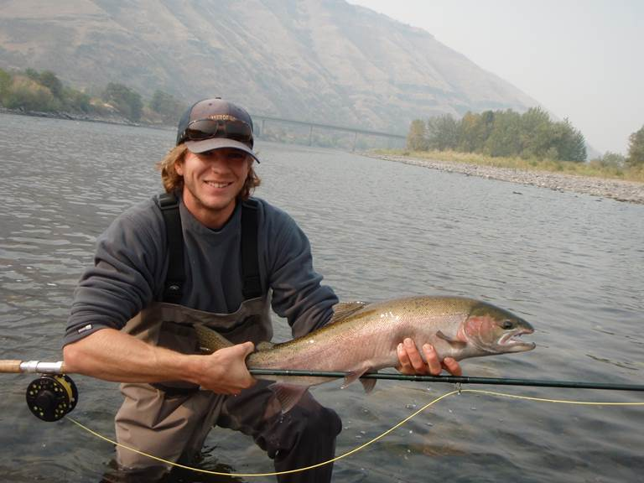
Acknowledgements
Sam Bourret, MSc
Dr. Chris Caudill
Sam: “Not a Chinook salmon”

Slide 3

Acknowledgments
NOAA – Kim Hatfield, Stephanie Burchfield
ODFW – Lisa Borgerson, Kanani Bowden, Tom Friesen, Wayne Vandernaald, Todd Alsbury, Jeff Ziller, Kelly Reis, Joy Vaughan, Shivonne Nesbit, Kirk Schroeder, Craig Tinus, Michele Weaver
UI – Travis Dick, Theresa Tillson, Dan Joosten, Charlie Erdman
WSU – Jeff Vervoort, Charles Knaack
PGE – Tim Shibahara
USACE – David Griffith,
Rich Piaskowski, and
Robert Wertheimer

Slide 4
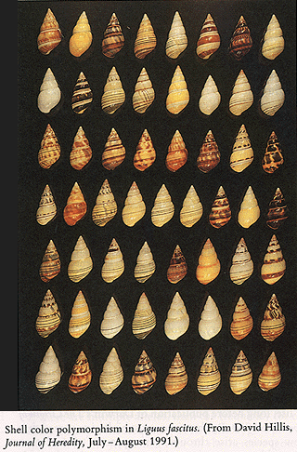
Presentation Objectives
Literature review and WIL data assembly
Examples of juvenile Chinook life history variation
Movement & emigration timing
Rearing habitat use
Life History ‘Types’ and ‘Pathways’
Upper Willamette spring Chinook
Life history variation among sub-basins
Within populations
Scale & Otolith datasets
Juveniles and adults
Back-assignment agreement?

Slide 5
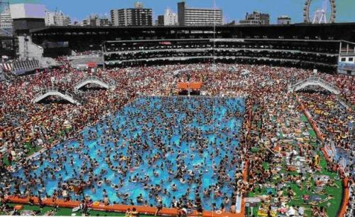
Broader goals
Estimate relative contribution of juvenile Chinook life histories to adult returns
Some will inevitably be more/less ‘successful’
Fitness & Population growth implications
Preserve ‘natural’ LH variation
Buffer population
Adaptation potential
Understanding =
effective management
of Willamette Chinook
Type 2: low productivity
Type 3:
highly
adaptive
Type 1: temperature
intolerant

Slide 6
Chinook life history review
The ‘historical’ concept (Mattson 1962)
“Early life history of WIL R spring Chinook salmon”
 |  | Subyearling ‘Ocean –type’ |  |  |  |  | Yearling ‘Stream-type’
 |  | Fall | Win | Spr | Su | Fall | Win | Spr | Su | Fall
Gravel
Emerge
Natal Trib
Main-stem
Estuary
Ocean
Notes:
Clemens: Mattson after impoundment

Slide 7
Conceptual bits
 |  | Subyearling |  |  |  |  | Yearling |  |  |  | 2-Year Old
 |  | Fall | Win | Spr | Su | Fall | Win | Spr | Su | Fall | Win | Spr | Su | Fall
Gravel
Emerge
Natal Trib
Non-natal river
Reservoir
Main-stem
Estuary
Ocean
Emerging paradigm: life history
variation along a continuum,
with many ‘pathways’

Slide 8
Chinook life history ‘pathways’
Stream-type yearling
Main stem-
Rearing
yearling
Reservoir-
type
yearling
Subyearling
Reservoir
‘entrapped’ 1+
Estuary-rearing
Bourret et al.
(in prep)
Notes:
Apologize to the color blind

Slide 9
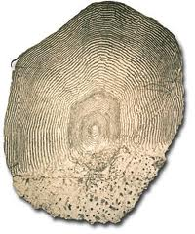
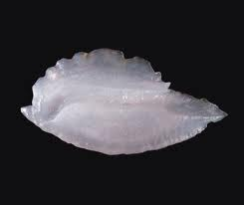
Life History review: How we know what we think we know
Juvenile tagging, trapping, mark-recapture
Luke Whitman: McKenzie case study (8:40 Wed)
Scale morphometry
ODFW Willamette Chinook database (OWCS)
Ben Clemens talk (this session)
Otolith microstructure and microchemistry

Slide 10
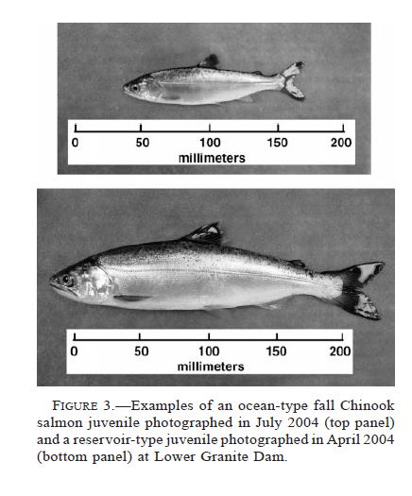
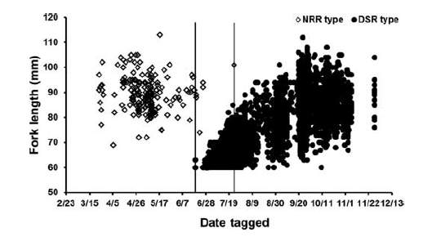
Chinook Life History (mark-recapture)
Snake River diversity
Ocean-type sub-yearling vs Reservoir-rearing yearling:
Lower Snake River
Stream-type Natal-Reach-Rearing vs Down-Stream-Rearing:
Marsh Creek, Middle Fork Salmon River
Copeland et al. 2014 (TAFS)
Connor et al. 2005 (TAFS)

Slide 11
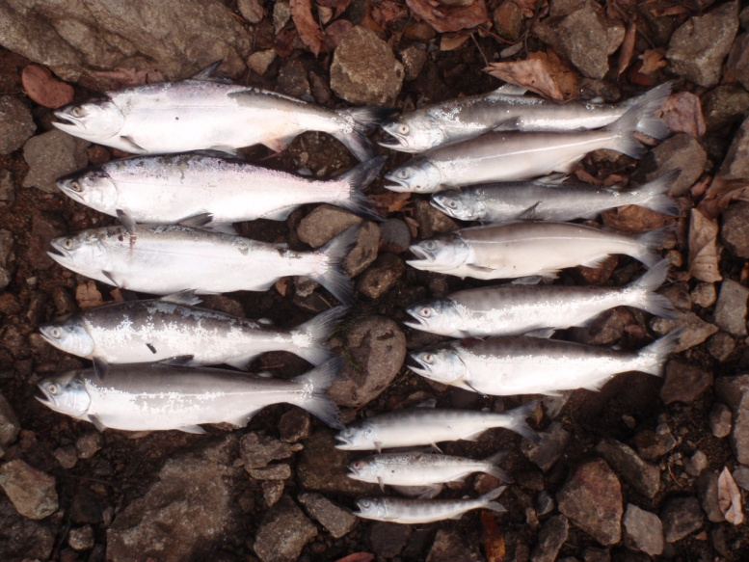
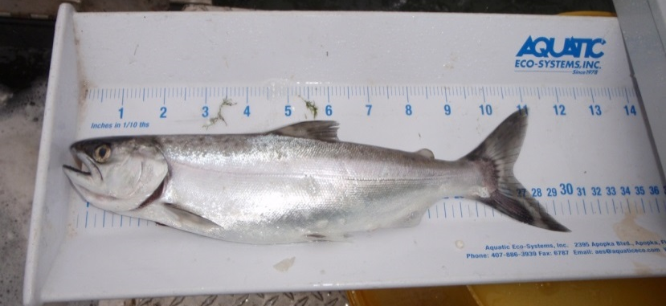
WIL Chinook life history (trapping)
Chinook captured in USACE screw traps
~2003-2010: Fall Creek, Middle Fork
~10 cm
Natal-reach
Downstream
~4cm
~28cm
Keefer et al. 2012 (Ecol Freshw Fish)
Notes:
Clemens: enlarge graph

Slide 12
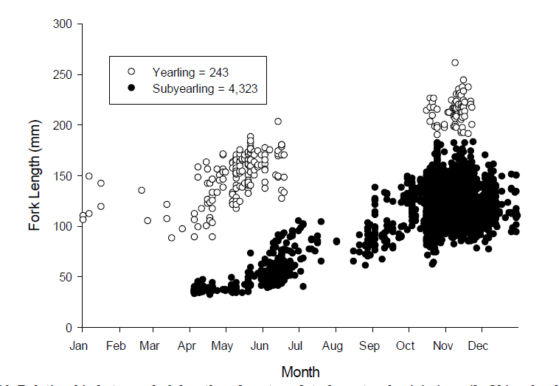
WIL Chinook life history (trapping)
McKenzie screw traps (ODFW)
Romer et al. (2014, report to USACE)
Wild Chinook below Cougar (SF McKenzie)
Age 1+ (2 summers)

Slide 13
WIL Chinook life history (scales & otoliths)
What we can learn from otoliths
Juvenile otoliths provide growth rate
Microstructure
Adult otoliths provide transition timing, age
Microchemistry differentiates river, estuary, ocean
What we can learn from scales
Age, growth rate, some habitat transitions
Morphology (+ chemistry in some cases)

Slide 14

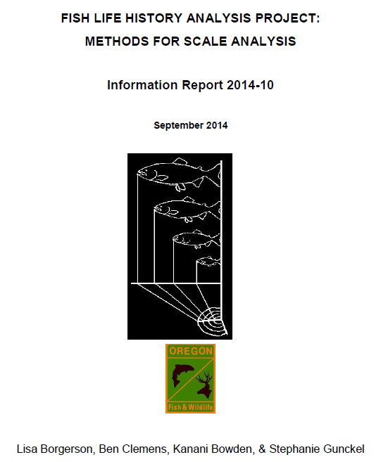

ODFW’s Chinook scale database
ODFW’s Willamette Chinook Salmon (OWCS)
Extensive archive
Large effort
1,000s of scales
with metadata
=
Life History goldmine

Slide 15
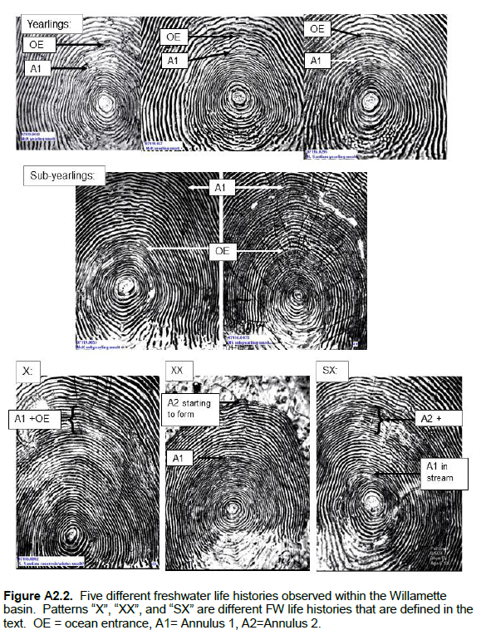
~5 freshwater life
histories for WIL
Chinook identified
from scale patterns
Age 1: ‘yearling’
1st Annulus before ocean entry
Age 0: ‘subyearling’
1st Annulus after ocean entry
Pattern XX:
2 reservoir
years
Pattern X: rapid growth;
Annulus ~ ocean entry;
‘Reservoir rearing’
Winter migrant
Pattern SX:
combined stream
+ reservoir

Slide 16
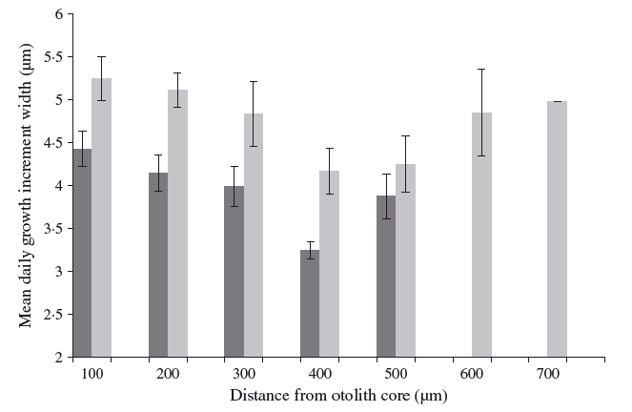
WIL Chinook juvenile otoliths
Middle Fork Willamette 2012-2013
Lookout Point reservoir
Mean daily growth: NFMF vs Lookout Point
Microstructure indicates
reservoir-rearing fish grow faster
Confirms scale growth data: type X
NFMF
Otolith isotope ratios: microchemistry shows
partial separation among rearing habitats
Signal in adult otoliths as well
Bourret et al. 2014
(J Fish Biol)
NFMF
LOP

Slide 17
2014: adult otolith work expanded
Sample otoliths from ODFW archive
Multiple Willamette sub-basins
Multiple years (2000-2011)
Compare otolith LH with scale LH classification
Total n = 128 adult otoliths with scale scores

Slide 18
WIL Chinook adult otoliths
Otolith core
Yearling life history
Transect
Continues
→
Maternal
signal
Marine value
Willamette Valley
First annulus
Sub-yearling life history

Slide 19
WIL Chinook adult otoliths
Ocean Entry: 673
First annulus: 710
Technically a Subyearling,
but ocean entry near annulus
Extended estuary rearing likely

Slide 20
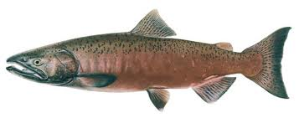
Adult scales and otoliths: is there juvenile life history classification agreement?
Freshwater age –
Structural and chemical
Do life history
classifications
match?
Juvenile growth and age
Notes:
Clemens: is this a tautology?

Slide 21
128 adult otoliths + scales (multiple sites)
ODFW Scale Classification
 | 0 | 1 | X | XX
0 | 100%
1 |  | 100%
X |  |  | 100%
XX |  |  |  | 100%
Otolith Classification
Otolith: Maternal end to Freshwater exit
0 1 X XX
Scale N = 30 29 44 25

Slide 22
128 adult otoliths + scales
ODFW Scale Classification
Modest agreement: Age 0 vs Age 1 (~81%)
Adult otoliths do not have clear X, XX signals
‘X’ growth evident in juvenile otoliths, but obscured in adult otoliths
Technological constraint currently
 | 0 | 1 | X | XX
0 | 77% | 14% |  | 16%
1 | 23% | 86% | 100% | 84%
X
XX
Otolith Classification

Slide 23
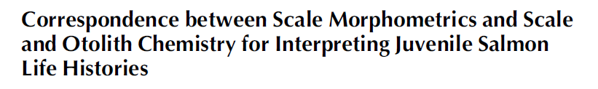
Adult scales and otoliths: agreement?
Two objectives:
Scales reliably capture high juv growth rate
Otoliths precisely capture ocean entry timing
Why are X, XX fish difficult to classify?
Reservoir-rearing fish enter ocean at age 0, 1, 1+
Annulus, saltwater entry overlap
 | Adult Scales | Adult Otoliths
Juvenile growth | ++ | +
Ocean entry | + | +++
Campbell et al. 2015 (TAFS)

Slide 24
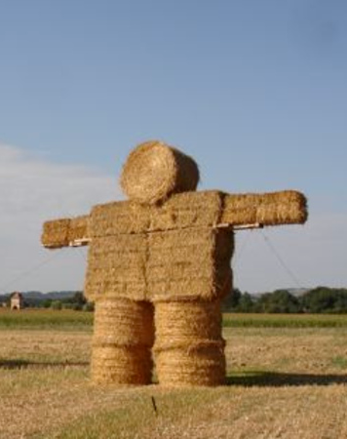
Relative performance straw man
Current status: several sources of uncertainty regarding ‘relative’ contribution of LH types
Classification accuracy
Juvenile abundance × life history type
Smolt-to-adult survival (SARs) × life history type
Straw man proposal: a simple idea intended
to generate discussion and to provoke
the generation of new and better proposals.

Slide 25
Relative performance straw man
OWCS Scale database example: “Snapshot”
Multiple years combined (~2000-2013)
Total N = 6,195 (some ambiguous fish censored)
N = 991
183
1903
1698
487
432
125
288
Major operational change!
Within-basin composition
also can vary widely
among years
Notes:
Change color for color blind

Slide 26
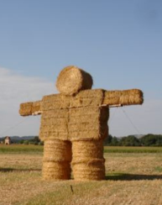
Relative performance straw man
S Santiam hypothetical: 4,000 adults (Foster)
Juvenile life history composition (prev. slide)
63% subyearling, 22% yearling, 15% type ‘X’
Management alternatives to increase adults:
Increase juvenile abundance
Increase SARs
Shift LH composition
4,000 adults
SAR = 1%
~400,000 juveniles
2,520 subs
880 yearlings
SAR = 4%
~100,000 juveniles
600 ‘X’
Notes:
Where on these curves is the management target?

Slide 27
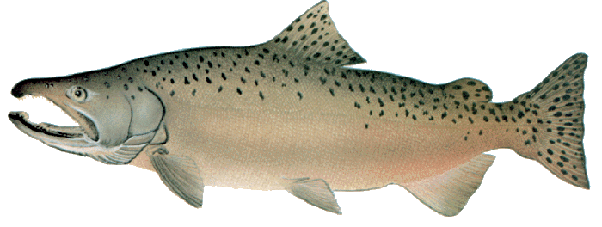

Looking forward
Lots of LH variation in Willamette Chinook
Expect continued confirmation and refinement
Tools for LH classification have advanced
Multi-lab scale classification QA/QC planned
Expect rapid learning from ODFW datasets
PIT data will provide SARs for some groups
Brandt et al. (next presentation)
Many potential management applications

